Slide 1
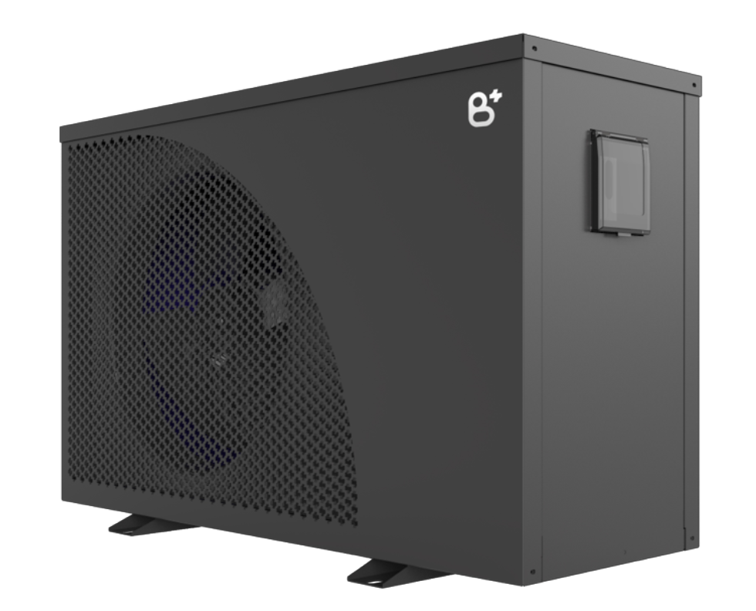

Heat pump settings
in combination with the BlueMatic app
Version 4.0

Slide 2
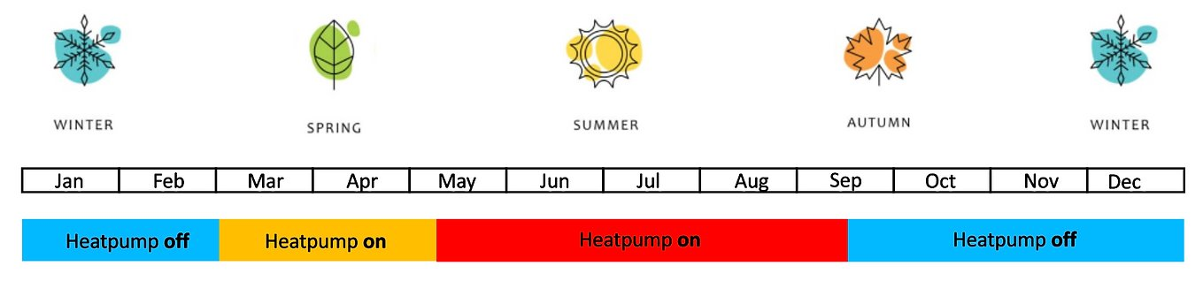
General principle of the use of SmartEnergy
During the pre-season, when you don't plan on swimming normally, you can activate the SmartEnergy to gradually heat your pool with free electricity (overproduction from your solar panels) so that you are ready for the start of the swimming season. The water temperature does not matter during this period. Of course, you can determine the activation period/months yourself.
Go to "Pre-Season" to see the specific settings
During the swimming season, it is of course important that your pool has a pleasant temperature for swimming.
You can activate the SmartEnergy to buffer the heat during this swimming season by using free electricity from the overproduction of your solar panels.
Go to "Swimming Season" to view the specific settings

Slide 3
Flowchart
To determine the desired setting

Slide 4
Way
Of
work
(Option 1a) Fully manual
without SmartEnergy
Yes
Manuel
Swimming
season
Use
SmartEnergy?
(Option 2a) Automatic without SmartEnergy
Automatic
Manière
de
travail
(option 1b) Fully manual
with SmartEnergy
No
Manuel
Start
Which season ?
Automatique
(Option 2b) Automatic with SmartEnergy
Pré-saison
Use
SmartEnergy?
(Option 3) Automatic with SmartEnergy
Yes
No
(Option 1a) Fully manual
without SmartEnergy

Slide 5
Settings during
Swimming season

Slide 6
4 ways to control your heat pump:
(Option 1a) Fully manual (ON/OFF) without SmartEnergy
(Option 1b) Fully manual (ON/OFF) with SmartEnergy
(Option 2a) Automatic without SmartEnergy
(Option 3b) Automatic with SmartEnergy

Slide 7
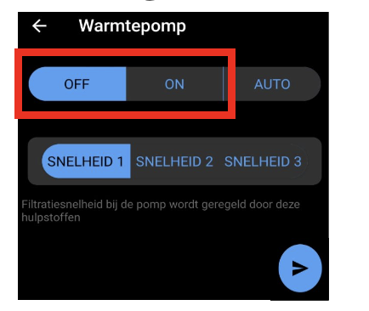
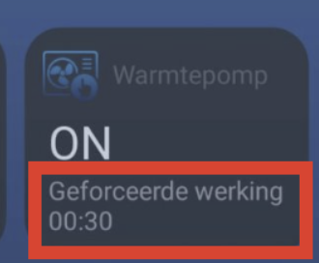
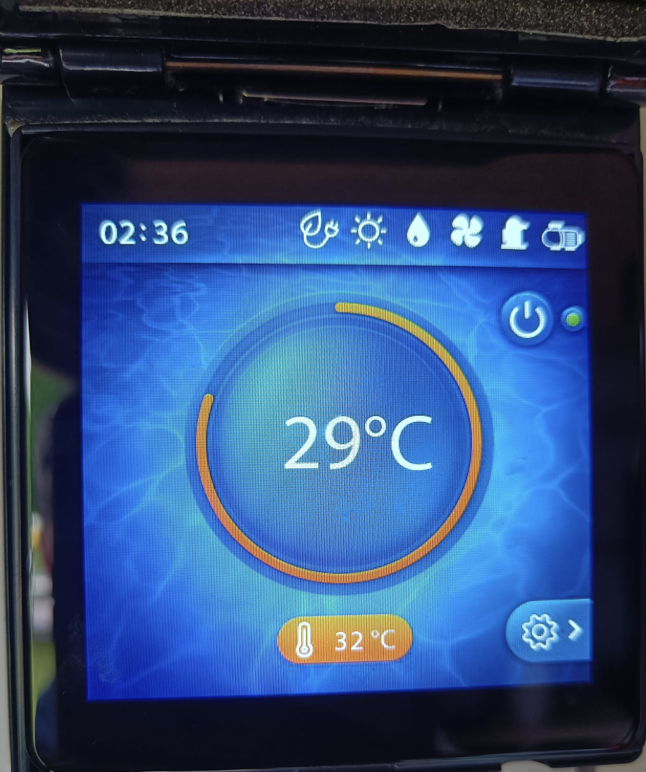
(1b) Fully manual with SmartEnergy
Completely identical to option 1a and the use of SmartEnergy actually makes no sense since the system wants to reach the temperature anyway which is physically set on the heat pump anyway
For example, in this case, it could be 32 degrees
Should the set temperature be set to
The heat pump screen is.
When sufficient overproduction is recorded
The system will indicate a "forced operation".
But the heat pump was going to strive to reach its physically set temperature anyway.
Therefore, there is no difference between with and without SmartEnergy in the manual setting.

Slide 8
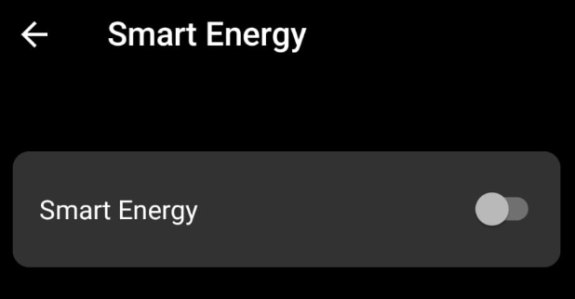
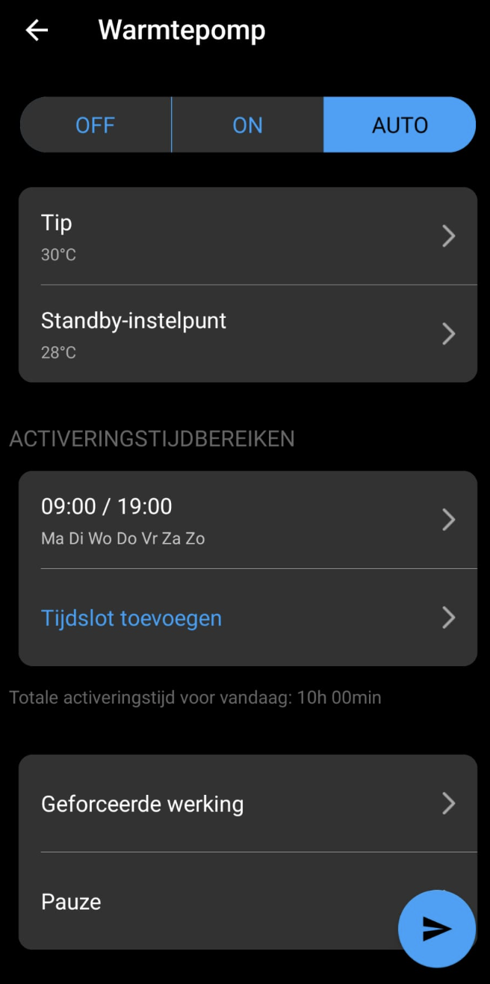
(2a) Automatic
without Smart Energy
Smart Energy af
Setpoint: The "Tip" temperature is the temperature at which the heat pump must operate for the defined period of time.
By setting the "Tip" temperature to the bathing temperature (e.g. 30 degrees) during the defined period/time, the heat pump will operate up to this temperature.
Standby temp: The temperature below which the water must never fall. The system heats up anyway when it falls below this value (e.g. at night)
In practice, this results in the following:
Between 9 a.m. and 7 p.m., the heat pump will operate at 30°C with the energy available (paid and overproduced if available). Since it will always work during the day, the risk of using overproduction is high, and your efficiency will increase as you suck in warmer air.
The tip can be lowered or increased according to your preference. Always set the standby temperature about 3 degrees lower so that the pump never runs outside of the schedule (the bath will never cool down by 3 degrees at night)
Please note!
In this case, when the temperature drops below 28 degrees, the heat pump will start working (even at night!).
To prevent this, it's best to set the standby temperature low enough
If there is stagnant water at the temperature sensor (when the circulation pump is not running at night), the temperature can become lower than that of the pool and thus start the heat pump incorrectly. To avoid this, the app will run the circulation pump every hour if the circulation pump schedule is set to inactive.
Note: Keep in mind that the software will always take a margin of 1°C on the requested TIP temperature to prevent the heat pump from activating every tenth of a degree. So, in this case, the 30°C TIP will be around 31°C in practice

Slide 9
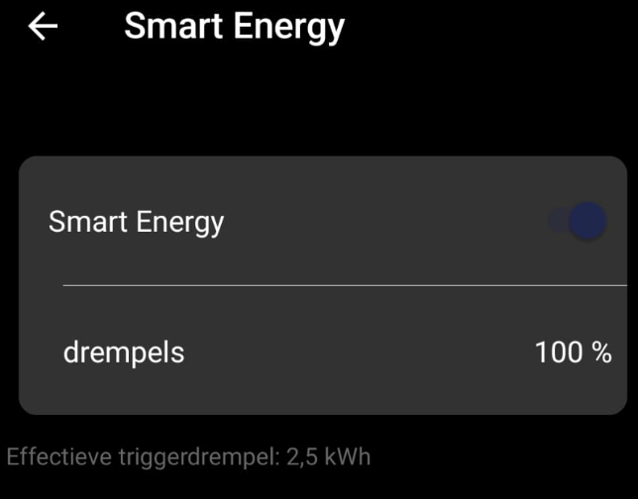
(2b) Automatic
with Smart Energy active
Smart Energy aan
Completely identical to option 2
But when there is sufficient overproduction
The heat pump will continue to heat up
above the "Tip" setpoint.
The upper limit is the temperature that
physically tuned to the heat pump.
For example, in this case, it could be 32 degrees
Should the set temperature be set to
the heat pump display.
The 100%, 75% and 50% thresholds are overproduction of energy in kilowatts from your solar panels as soon as a heat pump is activated for at least 30 minutes.
These fixed capacities depend on your type of heat pump and have been defined by your pool specialist.
E.g.
100% or activation in case of overproduction of 0.9 kW
75% or activation at 0.7 kW of overproduction
50% or activation in case of 0.5 kW overproduction
FYI: Keep in mind that the software will always take a margin of 1°C on the requested TIP temperature to prevent the heat pump from activating every tenth of a degree. So in this case, TIP 30°C will be about 31°C in practice

Slide 10
Settings during
Pré-saison

Slide 11
2 ways to control your heat pump:
(Option 1a) Fully manual
(Option 3b) Automatic with SmartEnergy

Slide 12
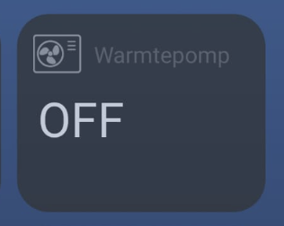
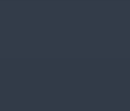
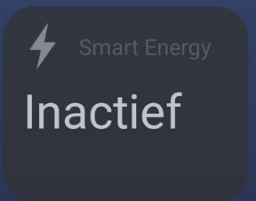
(1a) Fully manual
In the BlueMatic app, use the "Heat Pump" settings under "Controls"
In winter, turn the heat pump to OFF.
To avoid freezing, it is best to ask your pool specialist what is the best solution for you (let the water through or completely disconnect the heat pump and let the water out)
In the BlueMatic app, use the "Smart Energy" settings under "Missions"

Slide 13
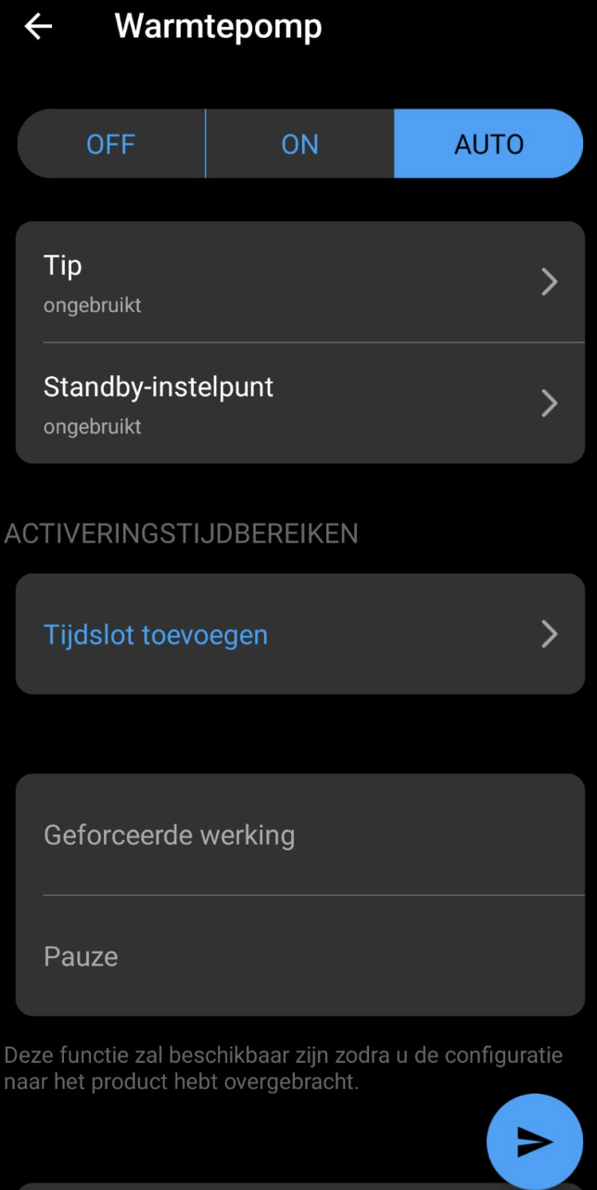
(3b) Automatic
with Smart Energy active
Peak set point: The peak temperature is the temperature at which the heat pump should operate for the defined period of time.
By setting the 'Tip' temperature to 'Unused', we do not set a temperature limit
Please note! Time lock must be removed
Otherwise, the heat pump would continue to heat "endlessly"
Standby setpoint: We have also set this to "Unused". During the pre-season, the temperature reached by the pool does not matter
In practice, this translates into the following:
The heat pump is only activated in the event of overproduction and is therefore available as free electricity. The heat pump then runs for 30 minutes and then checks if there is still enough overproduction to start the next 30-minute session.
Be sure to check which heat pump setting is ideal for your situation during this time (Eco, Boost,...)

Slide 14
Info SmartEnergy

Slide 15
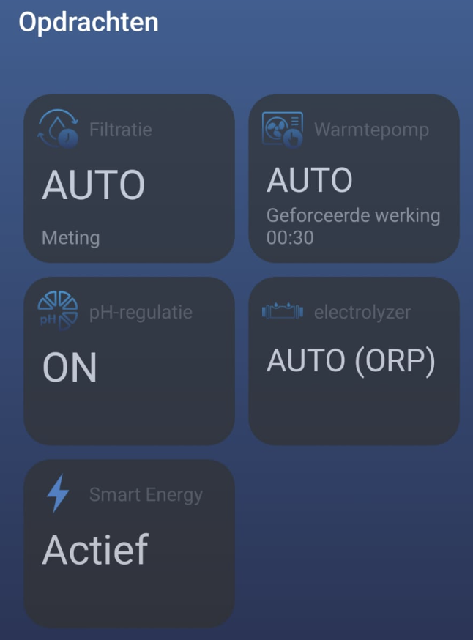
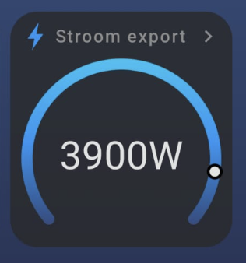
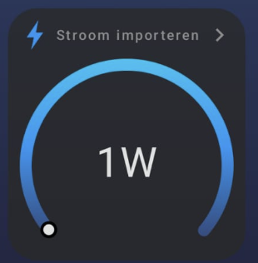
Info Smart Energy
If the heat pump is running on Smart Energy, this will be indicated as "Forced Operation" and there will be a 30-minute countdown to the next 30-minute session if there is still sufficient overproduction.
This indicates how much energy is put into the grid in the event of an overproduction of solar panels. Based on this value
Smart Energy will activate the heat pump
If you activate Smart Energy, you can set a threshold from the number of watts of overproduction that your heat pump will start for at least 30 minutes.
In this case, at 100%, it's an overproduction at 2500 Watts.
In this example, there is an overproduction of 3900 watts and so the heat pump will start working.
You can reduce this value by adjusting the percentages to 100%, 75%, or 50%
This indicates how much power is being imported from the grid for the whole house.
This value is zero (or 1) when there is overproduction.

Slide 16
Optional
Control of the heat pump when connected to WiFi or 4G

Slide 17
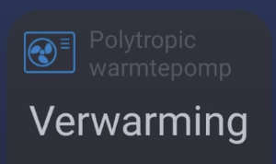
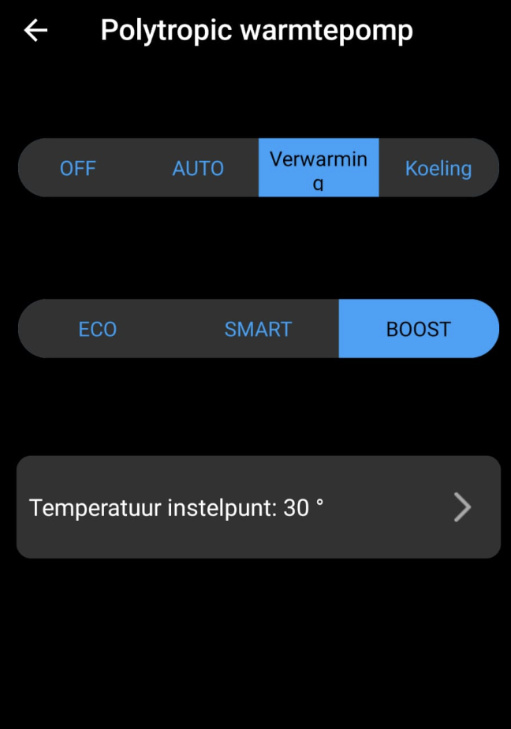
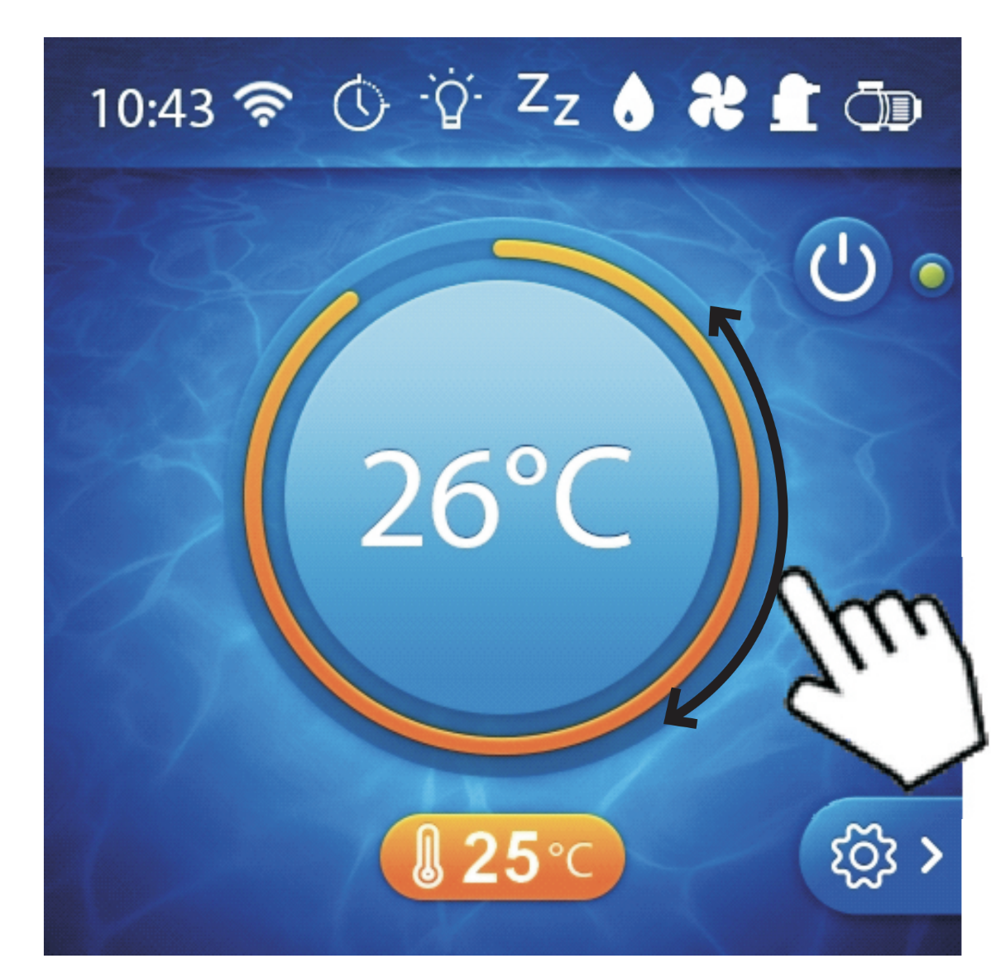
Info Parameters of the polytropic heat pump (if active)
In the BlueMatic app, open the "Polytropic heat pump" settings under "Controls"
This is controlled via the BlueMatic of your display on your Blue+ heat pump (if connected).
This can be useful for switching from Boost to Smart or Eco, for example

